Slide 1
Topological Data Analysis
Damian A. von Schoenborn

Slide 2
To go somewhere
We want a process that does not require assumptions about manifold structure, smoothness, lack of curvature, or the existence of a metric. [3]
TDA Defn: Given a finite dataset S[subset]Y of noisy points sampled from an unknown space X, topological data analysis recovers the topology of X, assuming both X and Y are topological spaces. [3]
Topology Defn: Intuitively, a topological space is a set of points, each of whom knows its neighbors. A topology on a set X is a subset T[subset]2^{X} such that:
See [3] p6

Slide 3
Agenda
Topology Review
Basics of Computational Topology
Persistent Homology
TDA

Slide 4
Topology Review (as relevant here)
Metric Space
Coordinate free
Orientation doesn’t matter
Small deformations don’t change topology
Stretching, bending, etc. okay
Cutting, gluing, etc. not okay
Simplicial Complexes
Course (“compressed”) representations of reality
Ability to compare sets from different coordinate systems
Pair-wise distance between points
Less sensitivity to noise ^{[1]}
Continuously defined surfaces

Slide 5
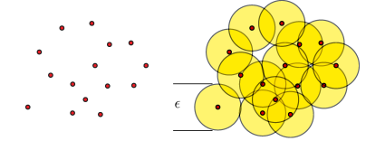
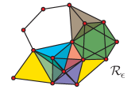
Creating the Vietoris-Rips Complex
Goal
Construct a combinatorial representation that approximates the underlying space from which the data was sampled [3]
Process
Create ε-balls around each data point
Draw an edge connecting each overlapping ε-ball pair
Describe with Betti Numbers
b₀: # of connected components
b₁: # of 1D holes
b₂: # of 2D holes
TO DO: BRING IN FORMAL DEFINITION FROM [3] p10
Ghrist [2]
Notes:
From a computational point of view, the Rips complex is less expensive than the corresponding Cech complex, even though the Rips complex has more simplices [2]. The Cech complex is not computed in practice due to its computational complexity [3]. Currently, the VR complex is one of the few practical methods for topological analysis in high dimensions [3].

Slide 6
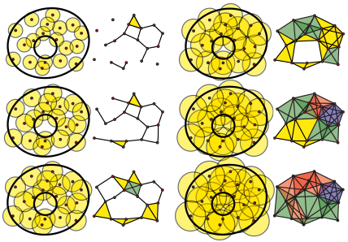
What features are an artifact of the chosen ε vs. a representation of the underlying structure?
Betti Numbers insufficient
Persistence
Features persisting over large range of ε values are significant
Features that quickly arise and drop off are noise and can be ignored
Ghrist [2]
Notes:
There is a narrow window where epsilon is large enough to remove all unwanted holes while keeping the only actual hole of the annulus.

Slide 7
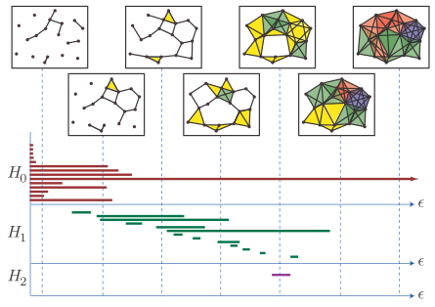
Use Barcodes to identify persistent homology
Ghrist [2]
Notes:
Barcodes are a parameterized version of a Betti number [2]

Slide 8
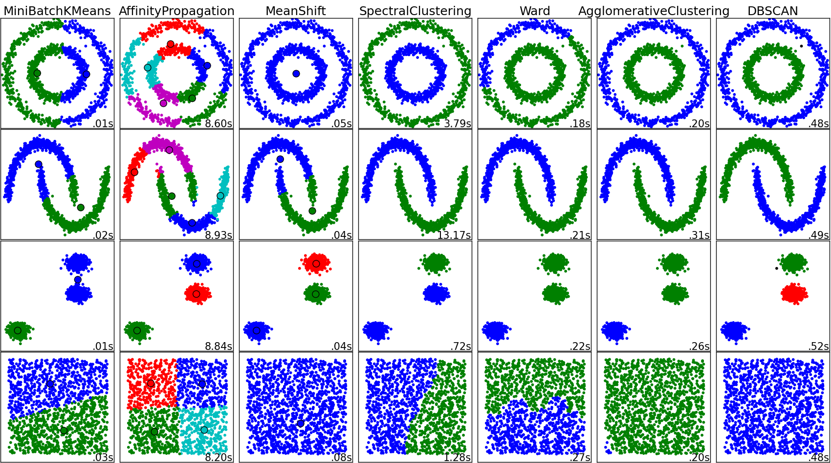
Potential Application

Slide 9
Benefits
Automated modeling
Choose models and parameters best suited to handle the type of dataset you’re analyzing
Pattern & shape recognition
Infer high dimensional structure from low dimensional representation ^{[2]}
Notes:
Also need to address that this technique isn’t idealfor Big Data as there’s a lot of computation (epsilon balls, pairwise overlap flags, etc. all computed for every epsilon value in range). Typically need to sample from data, reducing resolution.

Slide 10
Shrinking Data Size
Dimensionality Reduction
Record Consolidation
Principal Components Analysis
Loss of information
Assumes normality
Assumes that data is from a flat hyperplane with no curvature [3]
Cluster Analysis
Distinct groups, no relationship between them

Slide 11
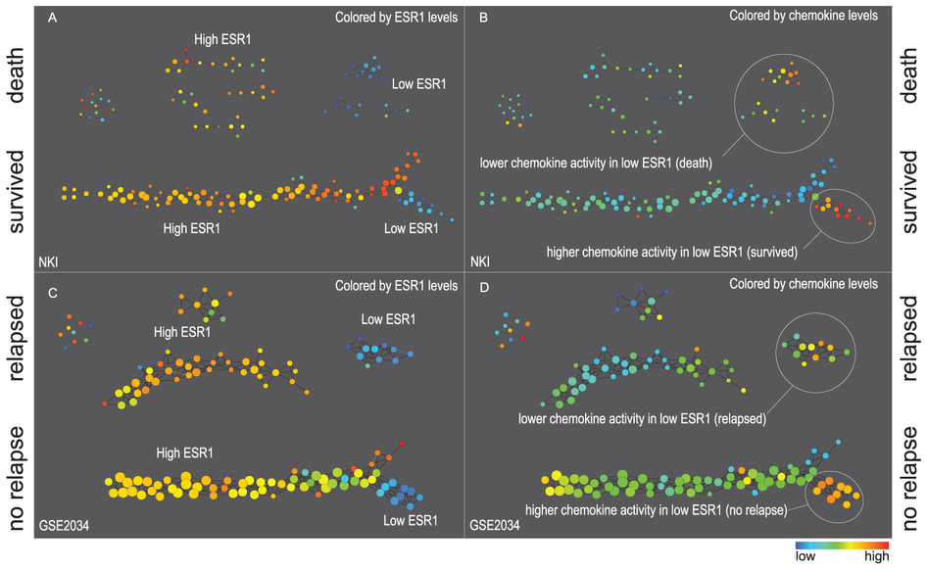
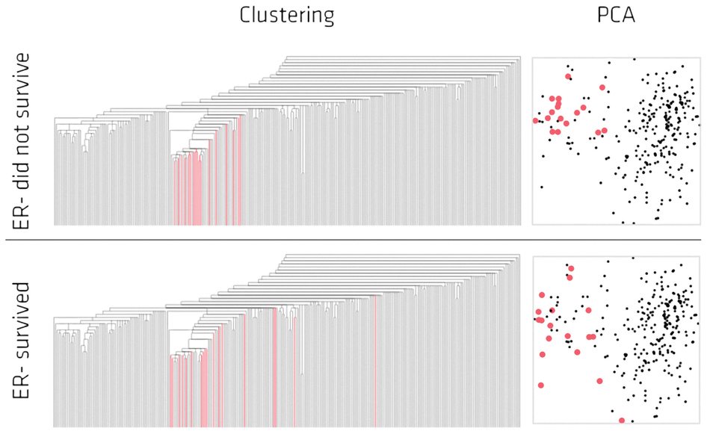
Application: Gene expression in cancer cells ^{[1]}
Traditional methods
TDA

Slide 12
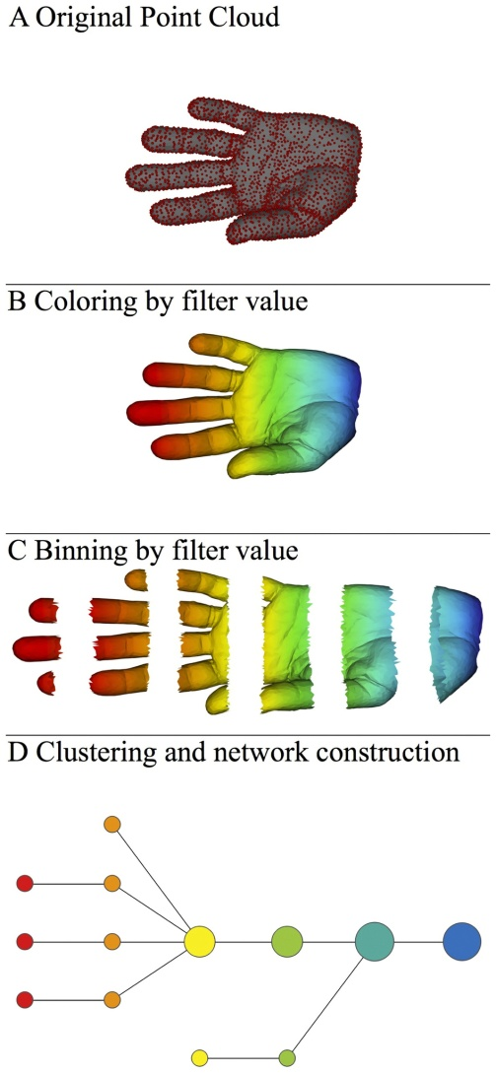
Process Overview
Discrete sample space
Filter value can be any combination of dimensions in the dataset or derived calculated fields
Slightly-overlapping bins
Simplified representation

Slide 13
Loops and Flares
Loops
Flares
Flares do not appear from random data

Slide 14
Benefits
Visual Exploration
Fungibility
Able to move away from hypothesis-driven analyses^{[1]}
Process can be applied to wide variety of data sources
No predefined format, scaling, etc. needed

Slide 15
References

Slide 16
Lum, P.Y. et al. Extracting insights from the shape of complex data using topology. Sci. Rep. 3, 1236; DOI: 10.1038/srep01236 (2013)
Ghrist, R. Barcodes: The Persistent Topology of Data. Bulletin of the AMS 45.1 pp61-75 S 0273-0979(07)01191-3 (2008)
Zomorodian, A. Topological Data Analysis. Proceedings of Symposia in Applied Mathematics. AMS (2011)

